Slide 1
Predicting Draft Round for College Football Skill Positions
By Chris Kourkoulakos
Brown University
October 24, 2024
https://github.com/ckourkou/DATA-1030-Final-Project.git

Slide 2
Intro
Given college football player stats, predict what round players were drafted (or undrafted)
Important for scouting, draft strategy, trades, roster optimization
Data from Stathead - partner of Pro Football Reference
Six separate data sets merged into one
Data collected on all college football players dating back to 1956
Major passing, rushing, receiving stats from games played
Filtered year to 1993
Classification problem - 8 groups (7 rounds plus undrafted group)
Challenge: missing data

Slide 3
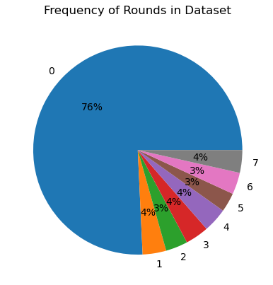
EDA

Slide 4
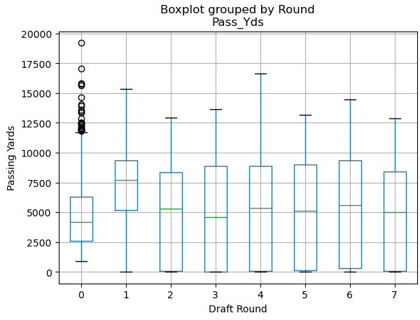
EDA

Slide 5
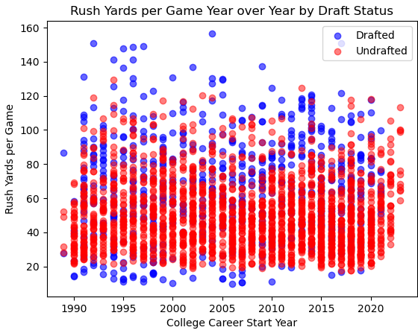
EDA

Slide 6
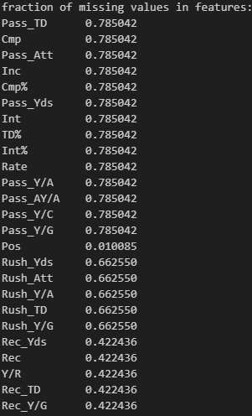
Splitting and Preprocessing
Many missing values
Mostly due to merging, some missing by nature
Position filled in by max of passing, rushing, receiving yards
Football metrics replaced with 0
Stratified split because of disproportionate amount of undrafted players
One-hot encoded features
Position, Years (From and To)
Multilabelbinarizer features
Team
MinMax scaled features
Completion %, TD %, Int %
Standard Scaled features
Everything else
29 columns in training data prior to preprocessing, 244 after
5295 rows

Slide 7
Questions?

